Slide 1
Module review – part 2 Dr Mariana Rocha School of Computer Science
CMPU 2007 Databases 1, Lecture 12

Slide 2
Inserting data
Before inserting data, consider:
The format of the table (the columns and their constraints)
The type of insert:
Full insert
Partial insert
All CHAR,VARCHAR and DATE fields must have their values surrounded by single quotes.
If we do not include a column list, PostgreSQL assumes you are inserting data in the column order it expects.
INSERT INTO table (column1, column2, ... column_n ) VALUES (expression1, expression2, ... expression_n );

Slide 3
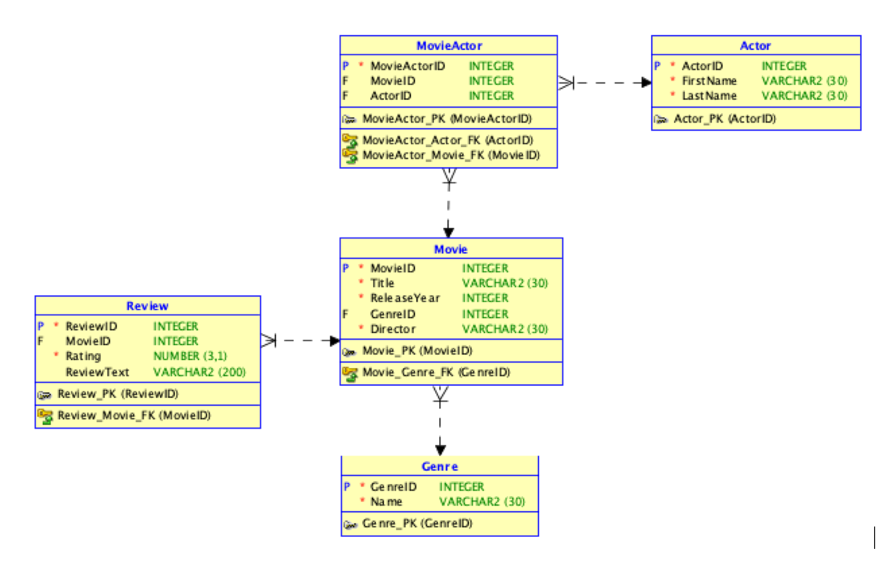
Winter exam – 2023/24

Slide 4
Winter exam – 2023/24
The following SQL queries were written as an attempt to insert data into the video game database. However, each query returned an error. Identify and explain the errors in the queries below:
INSERT INTO Movie
VALUES (102, 'The Shawshank Redemption', 1994, 'Frank Darabont');
INSERT INTO Actor (ActorID, FirstName, LastName)
VALUES (201, Tom, Hanks);
INSERT INTO Movie (MovieID, Title, ReleaseYear, GenreID, Director)
VALUES (101, 'Inception', 2010, 1, 'Christopher Nolan', 'christopher.nolan@gmail.com');

Slide 5
Winter exam – 2023/24
INSERT INTO Movie
VALUES (102, 'The Shawshank Redemption', 1994, 'Frank Darabont');
INSERT INTO Actor (ActorID, FirstName, LastName)
VALUES (201, Tom, Hanks);
INSERT INTO Movie (MovieID, Title, ReleaseYear, GenreID, Director)
VALUES (101, 'Inception', 2010, 1, 'Christopher Nolan', 'christopher.nolan@gmail.com');
The first SQL statement attempts to do a partial insertion without listing the attributes, which results in a “not enough values” error.
The second SQL statement attempts to insert a string value without single quotes, which results in an error.
The third SQL statement attempts to insert more values than attributes available, resulting in the error “too many values”.

Slide 6

Using the NULL Conditions
Test for nulls with the IS NULL operator.
SELECT firstname, lastname FROM mm_customer
WHERE on_mailing_list IS NULL;

Slide 7
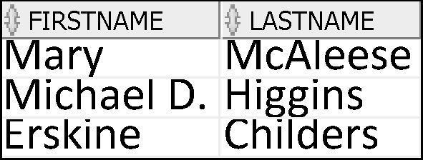
Using the NULL Conditions
Test for non null values with the IS NOT NULL operator.
SELECT firstname, lastname FROM mm_customer
WHERE on_mailing_list IS NOT NULL;

Slide 8
Winter exam – 2023/24

Slide 9
Winter exam – 2023/24
Write an SQL query to list the full names of actors who have never been in any movies.
SELECT CONCAT(A.FirstName, ' ', A.LastName) "FullActorName"
FROM Actor A
LEFT JOIN MovieActor MA ON A.ActorID = MA.ActorID
WHERE MA.MovieID IS NULL;

Slide 10
SQL Functions
Input
Output
Function
arg 1
Function performs action
arg 2
Result value
arg n

Slide 11
Two Types of SQL Functions
Functions
Single-row functions
Multiple-row functions
Return one result per row
Return one result per set of rows

Slide 12
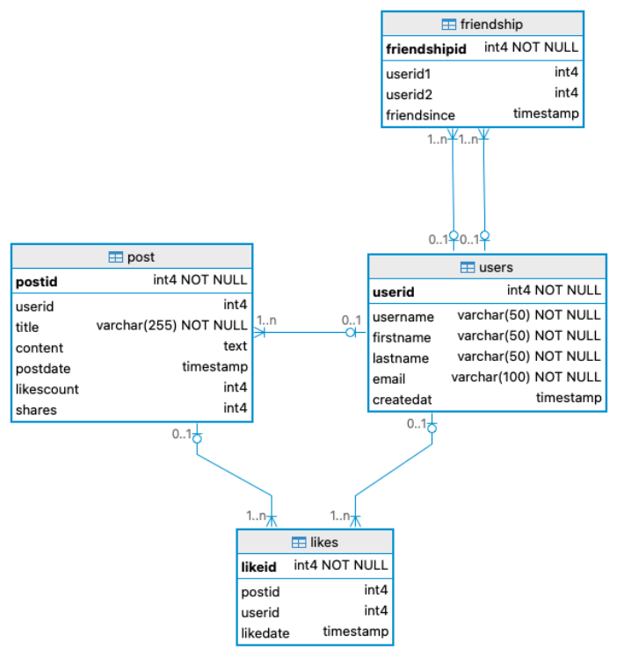
Winter exam – 2024/25
The following relational schema and interpretation will be used in subsequent questions:
A team of developers designed a database system for managing information related to a social media platform. This platform allows users to share posts, like posts, and connect with friends.
The database structure includes tables such as User, Post, Like, and Friendship. Users can view posts shared by their friends, besides being able to like posts, and interact with the platform by sharing their own content.

Slide 13
Winter exam – 2024/25
Write an SQL query to retrieve each post's title along with its average number of likes.
SELECT P.Title, AVG(L.LikeCount) AS AverageLikes
FROM Post P
JOIN "Like" L ON P.PostID = L.PostID
GROUP BY P.Title;

Slide 14
Types of Group Functions
AVG
COUNT
MAX
MIN
SUM
Group functions

Slide 15
Restricting group results with the HAVING clause
When you use the HAVING clause, the PostgreSQL server restricts groups as follows:
Rows are grouped by the expression you have given.
The group function is applied.
Groups matching the HAVING clause are displayed.
SELECT FROM [WHERE
column, group_function table
condition]
[GROUP BY group_by_expression] [HAVING group_condition] [ORDER BY column];

Slide 16
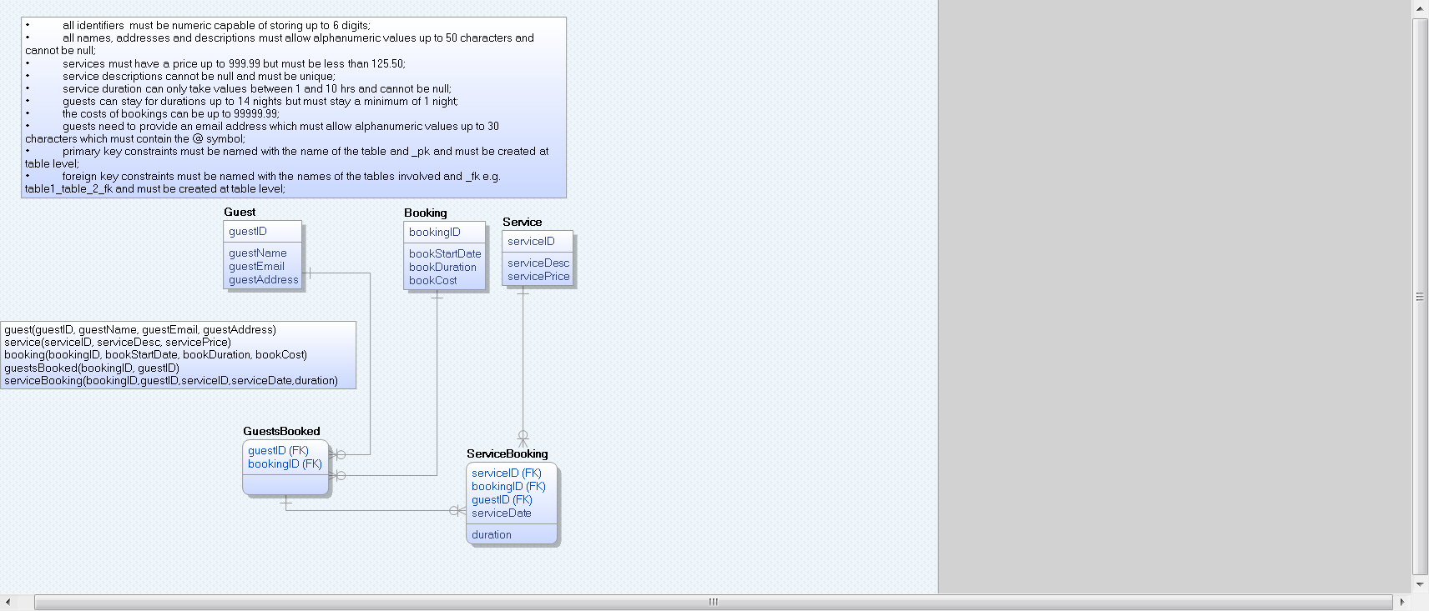
Winter exam – 2016/2017

Slide 17
Winter exam – 2016/2017
Suppose we want to calculate the total number of services used by a guest on a particular visit. Write SQL to achieve this.
Restrict the output so that only bookings with IDs between 1001 and 1005 are included. Format your output to follow this template:
‘The number of services used in by <guestID> in <bookingID> is <no. of services>.’
Hint: You do not include the < > in your output. Retrieve bookingID, guestID and calculate the no. of product.
SELECT 'The total number of services used in booking ' || bookingId || ' by ' || guestId || ' is ' || count(serviceID)
FROM serviceBooking
GROUP BY bookingId,guestID
HAVING bookingID BETWEEN 1001 AND 1005;

Slide 18
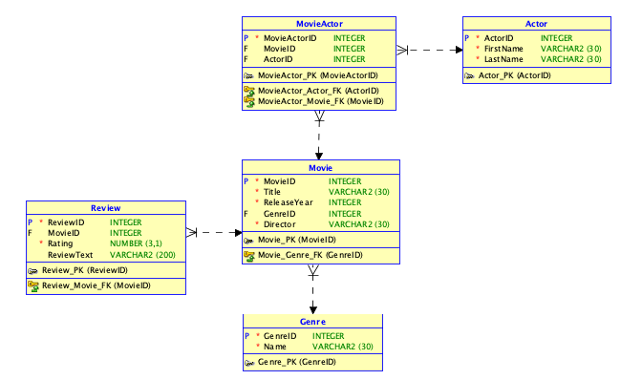
Winter exam – 2023/2024
Write an SQL query that retrieves the average rating for each movie in the Review table, along with the movie title.
SELECT M.Title, AVG(R.Rating) "Average Rating"
FROM Movie AS M
JOIN Review AS R ON M.MovieID = R.MovieID
GROUP BY M.Title;

Slide 19
JOINS
Inner Join: returns only matched rows between two tables
Outer Join: a join between two tables that returns the results of the inner join as well as the unmatched rows from the left (or right) tables is called a left (or right) outer join.

Slide 20
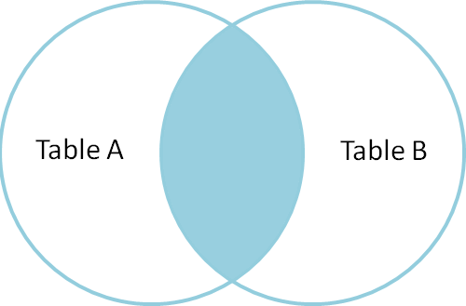
Inner join
Return the set of records that match in both Table A and Table B.

Slide 21
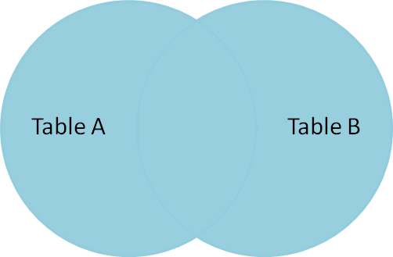
Full outer join
Return the set of all records in Table A and Table B, with matching records from both sides where available.
If there is no match, the columns from the missing side will be returned as null.

Slide 22
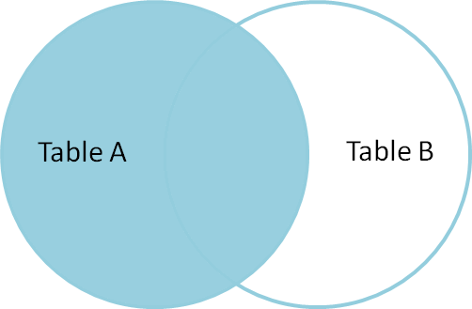
Left outer join
Return the set of records from Table A, with the matching records (where available) in Table B. If there is no match, the columns from the right side will contain null.

Slide 23
Right outer join
Return the set of records from Table B, with the matching records (where available) in Table A.
If there is no match, the columns from the left side will contain null.
Table A
Table B

Slide 24
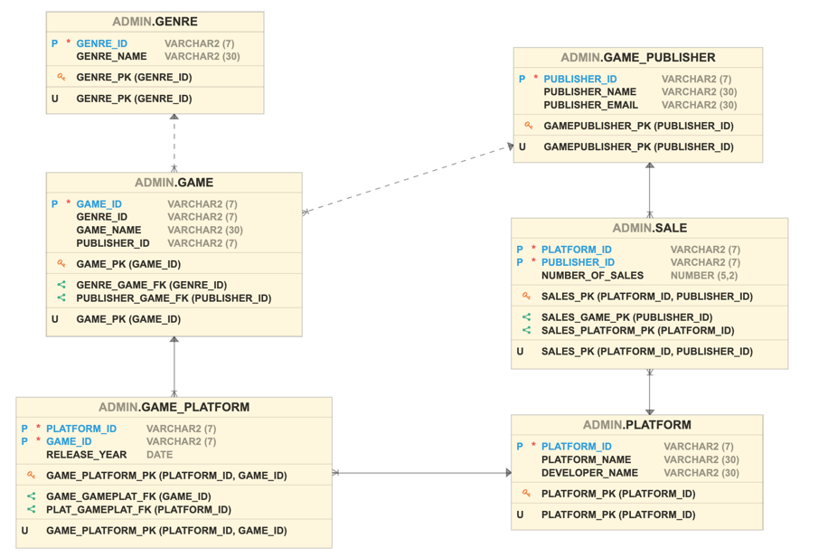
Winter exam – 2022/2023

Slide 25
Winter exam – 2022/2023
Q2a) Considering the relations between the tables game, game_publisher and sale, write the SQL query to retrieve the game_name, genre_id, publisher_name, and number_of_sales.
SELECT game_name, genre_id, publisher_name, number_of_sales
FROM game
JOIN game_publisher USING (publisher_id)
JOIN sale USING (publisher_id);

Slide 26
Winter exam – 2022/2023
Q2b) Rewrite the query you provided in question 2 (a) but modify the output by:
Renaming the columns as “Game Title”, “Genre Identifier”, “Name of the publisher”, “Sales”.
Display game_name and publisher_name in lowercase
SELECT lower(game_name) “Game title”, genre_id “Genre identifier”, lower(publisher_name) “Name of the publisher”, number_of_sales “Sales”
FROM game
JOIN game_publisher USING (publisher_id)
JOIN sale USING (publisher_id);

Slide 27
Winter exam – 2022/2023
Q3d) (d) To implement an efficient and consistent database, some integrity rules should be followed. Explain each of the following integrities and give examples of how these were followed in the video game database presented in question 1.
Entity integrity
Domain integrity
Referential integrity
Entity integrity: Ensures a unique, non-null value per row by using a unique identifier (primary key). One example is the attribute publisher_id.
Domain integrity: Ensures that only valid values can be input into columns, according to their datatype and value constraints. One example is the constraint added to the attribute publisher_email.
Referential integrity: Ensure consistency of values in tables that are related by adding a primary key of one table as a foreign key of another table. One example is the attribute publisher_id in the table game.

Slide 28
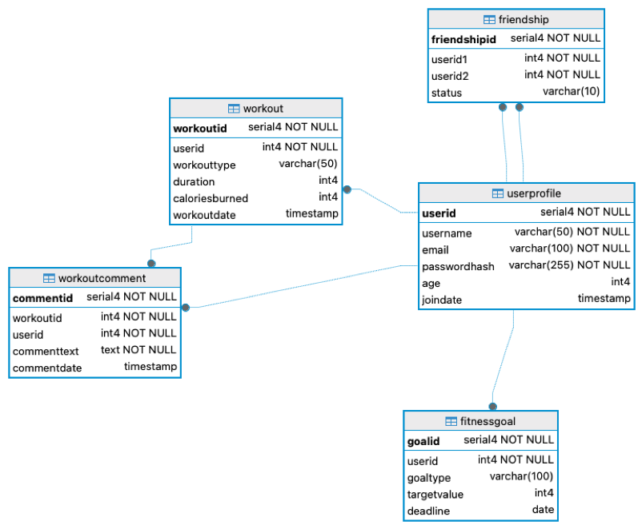
Semester 2 exam – 2024/2025 – TU857
FitLife is a social fitness tracking app designed for people who want to track workouts, set fitness goals, and engage with friends in a social fitness environment. The app allows users to:
Log workouts (e.g., running, weightlifting, yoga).
Set fitness goals and track progress.
Connect with friends and compare stats.
Leave comments on workouts to encourage each other.
The database stores users, workouts, fitness goals, comments, and friendships.
The following ERD represents the database that is part of the FitLife app.

Slide 29
Semester 2 exam – 2024/2025 – TU857
Q1(b) Write an SQL query to retrieve the usernames of users who have never logged a workout.
SELECT Username
FROM UserProfile
LEFT JOIN Workout USING (UserID)
WHERE Workout.UserID IS NULL;

Slide 30
Semester 2 exam – 2024/2025 – TU857
Q1(c) Write an SQL query to retrieve the user’s name and the total calories burned by each user. Rename the resulting columns as “Name” and “Total Calories”
SELECT UserProfile.Username “Name”, SUM(Workout.CaloriesBurned) “Total Calories”
FROM UserProfile
LEFT JOIN Workout USING (UserID)
GROUP BY UserProfile.Username;

Slide 31
VIEWS
A database view is a logical or virtual table based on a query.
It is useful to think of a view as a stored query.
They are useful ways of presenting different information to different users.
Views are created through use of a CREATE VIEW command that incorporates use of the SELECT statement and queried just like tables.

Slide 32
Defining Views
Suppose we have the following table:
Employee(PRSINO, name, department, project, salary)
Our HR department has permission to view information about all employees but the manager of the IT department only has permission to view the name of their staff and the name of the project on which they are currently working
We can create a view for the IT manager
CREATE VIEW IT AS
SELECT name, project FROM Employee
WHERE department = ‘IT’;

Slide 33
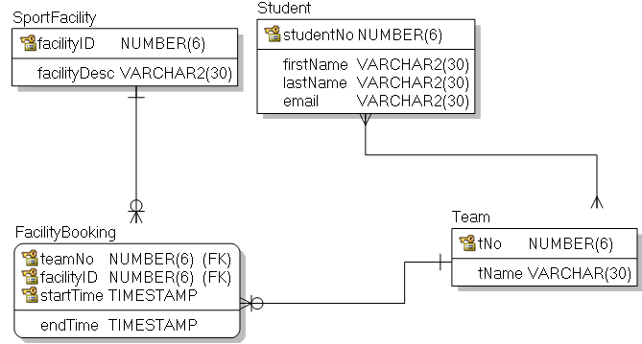
Winter exam – 2018/2019

Slide 34
Winter exam – 2018/2019
Using UNION write the SQL needed to create a VIEW called FacilityUse which has details about the number of bookings for each facility. You need to:
Include a column facility which is the facility description;
Include a column bookings which holds the number of bookings for that facility.
The SQL should be based on the SQL you wrote for parts (a) and (b) so you will need to ensure a row is included for each facility whether it has bookings or not.
CREATE VIEW FacilityUse AS
SELECT facilitydesc AS facility, count(teamno) AS bookings
FROM facilitybooking
JOIN sportfacility USING (facilityid)
GROUP BY facilitydesc
UNION
SELECT facilitydesc AS facility, count(teamno) AS bookings
FROM facilitybooking
RIGHT OUTER JOIN sportfacility USING(facilityid)
GROUP BY facilitydesc
HAVING count(teamno)=0;

Slide 35
Set Operators
A
B
A
B
UNION/UNION ALL
A
B
INTERSECT
A
B
MINUS

Slide 36

Using the UNION Operator
Display the current and previous job details of all employees. Display each employee only once, removing duplicates.
SELECT employee_id, job_id FROM employees
UNION
SELECT employee_id, job_id FROM job_history;

Slide 37


Using the UNION ALL Operator
Display the current and previous departments of all employees, including duplicates.
SELECT employee_id, job_id, department_id FROM employees
UNION ALL
SELECT employee_id, job_id, department_id FROM job_history
ORDER BY employee_id;
…
…

Slide 38
Using the INTERSECT Operator
Display the employee IDs and job IDs of those employees who currently have a job title that is the same as their job title when they were initially hired (that is, they changed jobs but have now gone back to doing their original job).
SELECT employee_id, job_id FROM employees
INTERSECT
SELECT employee_id, job_id FROM job_history;

Slide 39

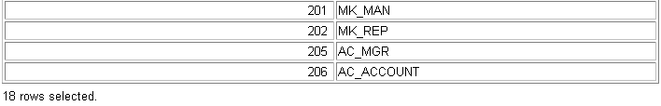
EXCEPT Operator
Display the employee IDs of those employees who have not changed their jobs even once.
SELECT employee_id,job_id FROM employees
EXCEPT
SELECT employee_id,job_id FROM job_history;
…

Slide 40
Winter exam – 2018/2019

Slide 41
Winter exam – 2018/2019
Using INTERSECT, write the SQL to find the students who are captain of at least one team and a player for at least one other.
You need only output studentno, firstname and lastname.
SELECT studentno, firstname, lastname
FROM teammember
JOIN student USING (studentno)
WHERE teamrole='Captain'
INTERSECT
SELECT studentno, firstname, lastname
FROM teammember
JOIN student USING (studentno)
WHERE teamrole='Player’ OR teamrole IS NULL;

